Slide 1
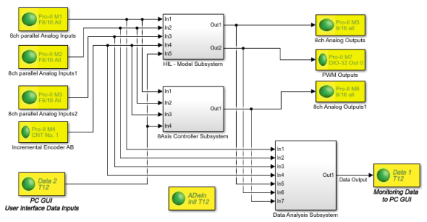
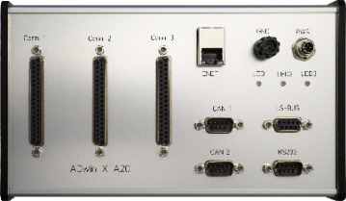
April 2021
Shortform Information
ADwin
Fast Real-Time Systems
Real-Time Models in Simulink®
Data Acquisition with Matlab®

Slide 2
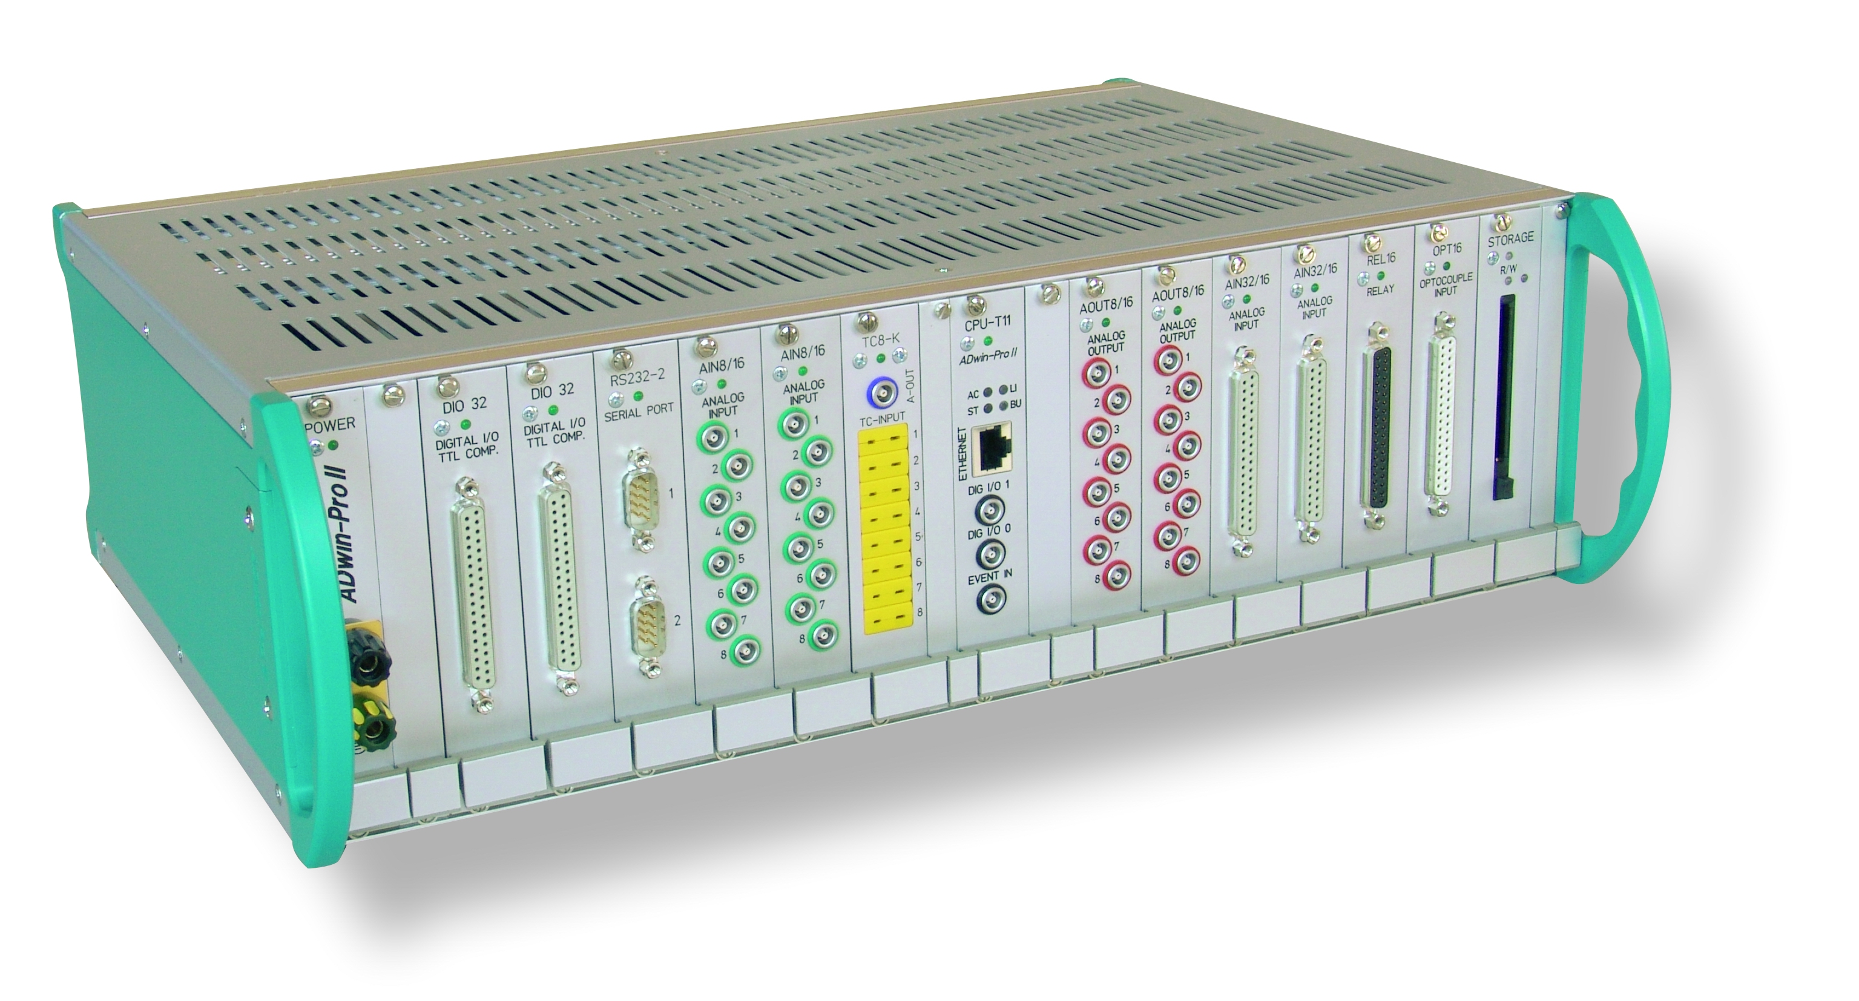
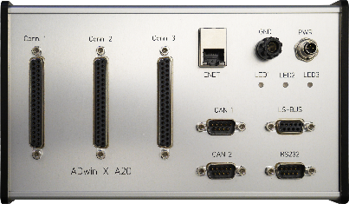
ADwin
Fast Real-Time Models in Simulink®
Data Acquisition with Matlab®
Standard Systems and Products
ADwin offers a large variety of different hardware and software products, developed by experienced engineers.
All applications and functions always run absolutely deterministically and very fast in Real-Time.
Models for ADwin systems are built by Simulink® using the blockset ADsim and the development tool chain.
ADwin runs Simulink® models with ‘µs’ cycle times,
and with a ‘ns’ timing precision, while applications with Matlab® may run on an even higher speed.
Simulink® on ADwin in Real-Time
Complex large models @ high speeds
Parallel models, multitasking, priority controlled
Controllers, data acquisition, signal analysis, filters, bus communication, state machines, …
Benchmark example: 16 x PID @ 300 kHz
RT cycle frequency up to 500 kHz / 1 MHz
DAQ with ADwin and Matlab®
Acquisition of various signals
Parallel acquisition of channels from kHz to MHz
Analog, digital, counter, serial bus signals
Real-Time pre-analysis, intelligent acquisitions
Matlab® based analysis and visualization
Complex triggers, data reduction
Application Fields
Test stand control and data acquisition
Customized machine automation
Dynamic component testing
End-of-Line (EOL) testing
Hardware-in-the-Loop (HIL)
Rest-bus simulation
Fast machine control applications
Experiment control (Physic world)
Automotive, Aerospace
Green Energy and White goods
Scientific Physics Experiments
Research applications and Prototype development

Slide 3
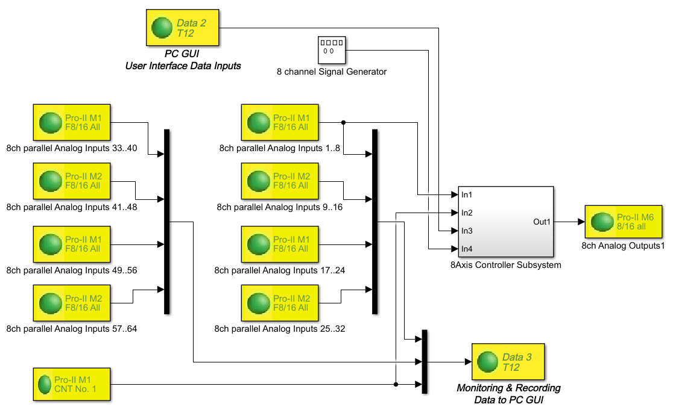
ADwin
Real-Time Models in Simulink®
ADsim Blockset - Simulink® models in fast Real-Time
With the blockset ADsim, you easily run Simulink® models on ADwin hardware systems in Real-Time, very fast with ‘µs’ cycle times, and with a ‘ns’ timing precision.
With a few clicks only, just insert ADwin hardware I/O blocks into the model and build your own Real-Time model. After compilation, what takes a few seconds only, the model runs on the ADwin system fast in real-time, absolutely deterministically, and with a high timing precision. Typical model execution frequencies are from high kHz range, via hundreds of kHz, up to 500 kHz/1 MHz.
The Simulink® models are executed inside ADwin by a local system CPU, on a highly optimized multitasking Real-Time operating system. The Real-Time process cycle time is adjustable in 1 ns steps. Benchmark Example: With a few clicks you run for example 8 x analog inputs + filter + controllers + analog outputs at 500 kHz. ADsim allows multiple I/O trigger synchronization modes in order to cover flexible application requirements.
ADsim is available for ADwin-Pro-II and ADwin-X-A20.
Typical ADwin & ADsim applications are test stand control and data acquisition, customized machine automation, dynamic component testing, End-of-Line (EOL) testing, Hardware-in-the-Loop (HIL), Rest-bus simulation, and many more.
Please feel free to receive further information about ADwin & ADsim or get an Online Demo with just a click:
www.ADwin.us
Fast and deterministic Real-Time
Complex models running
From kHz, hundreds of kHz to MHz
Accurate and deterministic timing
‘µs’ cycle times with ‘ns’ timing precision
Some seconds for code compilation only
ADwin Systems
ADwin-Pro-II and ADwin-X-A20
Local Real-Time CPU
Analog-I/O, digital-I/O
Counter, incremental encoder
CAN®, CAN-FD®, SENT®, LIN®, etc.
PROFIBUS®, PROFINET®
EtherCat®, DeviceNet®, etc.
Standard ADwin systems
Additional OEM customized systems
Driver tool chain
Matlab® and PC programming languages and DAQ environments
ADtools, ADsimDesk
Data exchange between PC user interface and Real-Time model
Online tuning of Simulink® blocks
Ethernet for PC communication
Windows®, Linux, OSx

Slide 4
ADwin
The ADwin concept
The ADwin concept
ADwin systems are freely programmable by the user so that the software of the system can be adapted for any kind of a customized solution. This makes ADwin an universal platform, suitable for many different types of functions, applications, and industries. Just use Simulink®, ADbasic, Matlab® and/or ADlab on ADwin for fast and precise Real-Time models or intelligent data acquisition.
ADwin systems are characterized by a deterministic execution of intelligent data acquisition and control applications. This is achieved by a local CPU, the Real-Time heart of every ADwin system. The CPU is responsible for all Real-Time functions and gua-rantees a fast, precise, and deterministic process execution, independent of the PC and its workload. User-created Real-Time code may be executed with kHz, hundreds of kHz up to MHz range.
ADwin systems work in close cooperation with the PC, running Windows or Linux on it, or OSx on a Mac, but there is a clear job sharing:
The job of the ADwin system is to execute fast and deterministic processes in Real-Time,
while the PC performs standard functions such as displaying graphical user interfaces for applications, visualization of data, and data base accesses.
Real-Time Functions
Intelligent data acquisition
Fast digital closed loop controller
Multi axis controller, PID, state space, and others
Online analysis of measurement data
Complex trigger applications
Online data reduction
Signal generation, arbitrary and adaptive
ADbasic Real-Time code
Simulink® models in Real-Time
ADwin systems add Real-Time capability to a Windows or Linux PC; if the PC crashes, the ADwin system will continue to run, maintaining the integrity of the application.
ADwin products cover a large variety of I/O types and interfaces, as well as a selection of different Real-Time CPUs. In addition to the CPUs, there is a large local memory for program code and measurement data, analog I/Os, digital I/Os, counters, different kind of serial interfaces for automotive, avionic and industrial serial busses, various expansions and options.
The communication between the ADwin system and the PC is done via Ethernet. Industrial bus interfaces allow the connection to PLCs and NCUs, while a bootloader supports complete stand-alone operations of the ADwin system if needed.
Real-Time CPU
ADwin-RT-OS
Multitasking
Bootloader
HDD/SSD
ADbasic
C-code functions
Simulink® models
~ ~ ~ ~ ~ ~
PC communication task
analog & digital I/O • PWM • counter •
quadrature encoder • signal conditioning
Application
Test stand
Machine automation
Experiment
Device under test
Sensor access
Actuator access
Bus communication
CAN • LIN • FlexRay • SENT • PSI5
• SPI • I2C • RT Ethernet • fast RS-422
MIL-STD-1553 • ARINC 429
CANopen • DeviceNet • Profibus •
RS-232/-422/-485 • PROFINET • EtherCat
Windows, Linux, Mac OSx
VB, .NET™, C#, Phyton™, Java™
LabVIEW™, Dasylab®,
Matlab®, Simulink®, Magali®, …
Ethernet • online data exchange

Slide 5
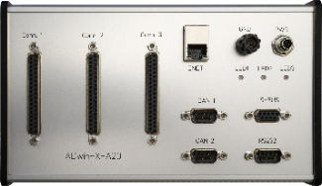
ADwin
– ADbasic –
Real-Time Development Tool Chain
ADbasic is an easy-to-use Real-Time software development tool for deterministic, time-critical processes on ADwin systems. Whether you need to run intelligent data acquisition with online analysis or complex trigger conditions, to use open- and closed-loop controllers such as multichannel PID and others, or to generate any kind of periodic or non-periodic waveforms, ADbasic is the key! We provide the development of various Real-Time applications with precise and deterministic operations and timings.
ADbasic is an integrated development environment that runs under Windows with many online debugging features. Its easy-to-learn, standard command syntax has been expanded with a number of functions to access all inputs, outputs and interfaces of an ADwin system, as well as functions for process control and for communication with the PC.
Along with ADbasic, the ADwin Real-Time operating system is optimized for the shortest possible response times. It manages parallel processes which can be executed on the same CPU in a multi-tasking mode, with different priorities and process cycle times.
ADbasic is source code compatible to previous versions; the same code can be executed on different ADwin systems with different CPUs. This means that by using ADbasic, the ADwin concept gives you a great advantage by using future hardware together with your currently-developed code. This saves on development costs over the long-term.
In the latest version, ADbasic 6.2 for T12-based CPUs in ADwin-Pro-II and ADwin-X-A20 provides a strong link to Simulink® and/or Matlab®.
ADwin Real-Time – with Sub-Microsecond Precision!
ADwin applications always run in Real-Time! Every sampled value can be evaluated in the same sampling step, so that a control function or an online analysis can immediately follow. The best solution for fast Real-Time applications is to place a dedicated CPU close to the signals with its own resources for flexible and freely programmable processing of measurement data. The ADwin CPU runs an optimized ADwin Real-Time multi-tasking operating system–only this combination provides exact, predictable process response times with less than 300 ns.
For even more precise timing, some ADwin systems provide a TiCo co-processor with response times down to 10 ns. The ADwin system can run multiple parallel tasks, each task with its own functionality, cycle time, and individual priority. Depending on the CPU, you can run applications with process cycle times from ‘ms’ down to ‘μs’ range, from kHz up to MHz, perfectly executed on ADwin with a high timing precision in Real-Time.

Slide 6
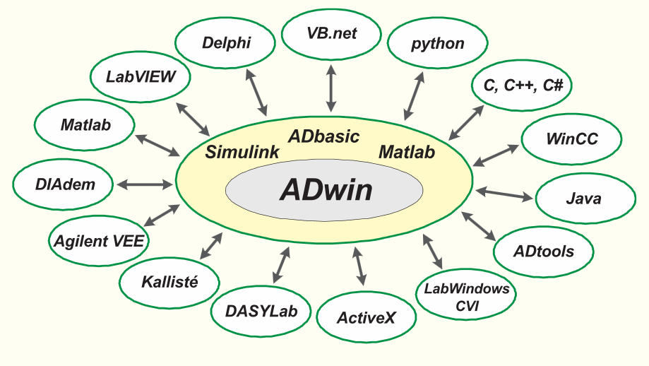
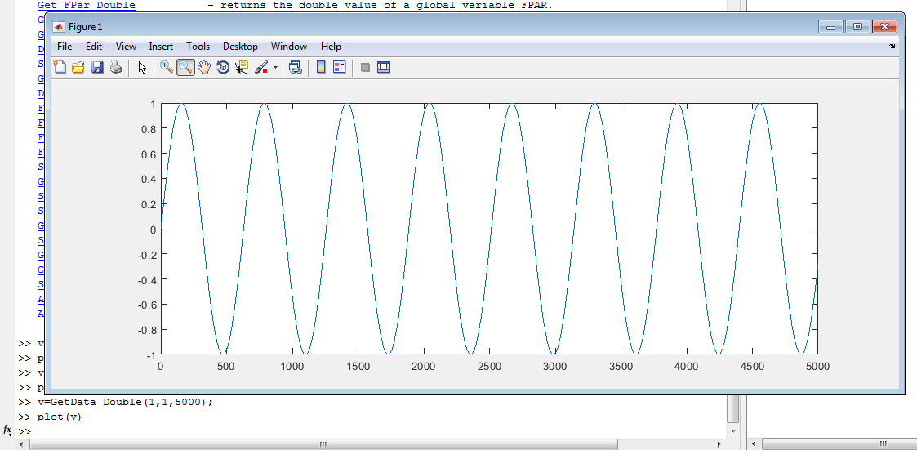
ADwin
DAQ with Matlab®
and General ADwin Drivers
Matlab® and ADwin / ADlab
Intelligent Data Acquisitions
Acquisition of various signals
Parallel acquisition of channels
Pre-analysis in Real-Time
Complex triggers
Data reduction
Matlab® based analysis
Visualization via Matlab®
_____
Key specifications:
kHz ... hundreds kHz ... MHz
Various signal types
Parallel synchronized acquisition OR individual acquisitions rates
ADbasic and Simulink® collaboration
_____
Analog Inputs, fast parallel & synchronized, with one ADC/channel or multiplexed (MUX)
Analog outputs, Digital I/O, counter, incremental encoder, SPI®, …
Filters, Thermo, Precise-RTD, LVDT®, …
PROFIBUS®, PROFINET®, EtherCAT®
CANopen®, DeviceNet®, Modbus®, …
CAN®, CAN-FD®, LIN®, SENT®, PSI5®, ARINC 429®, MIL-STD-1553®
SPI® master/slave, Manchester code, Generic RT Ethernet (UDP), …
Drivers are available for a wide range of PC programs under the Windows and Linux operating systems, as well as for OSx on Mac computers. ADwin drivers provide functions for communications between Matlab® or any other programming language or DAQ software environment on the PC and the ADwin system.
ADwin Real-Time processes, such as ADbasic code and Simulink® Real-Time models, may exchange data along with system status. Communication between the ADwin system and the PC is done via Ethernet (10/100/1000Mbit). One ADwin system can be addressed by several PCs, while a single PC can handle several connected ADwin systems.
One of the key benefits in the ADwin-to-PC communication is the possibility to run fast, absolutely deterministic Real-Time processes, and also to communicate data and parameters between the PC and the ADwin system at the same time. Neither has influence on the other: the communication does not disturb the deterministic timing of the Real-Time processes and vice versa.
Simulink®
Excel

Slide 7
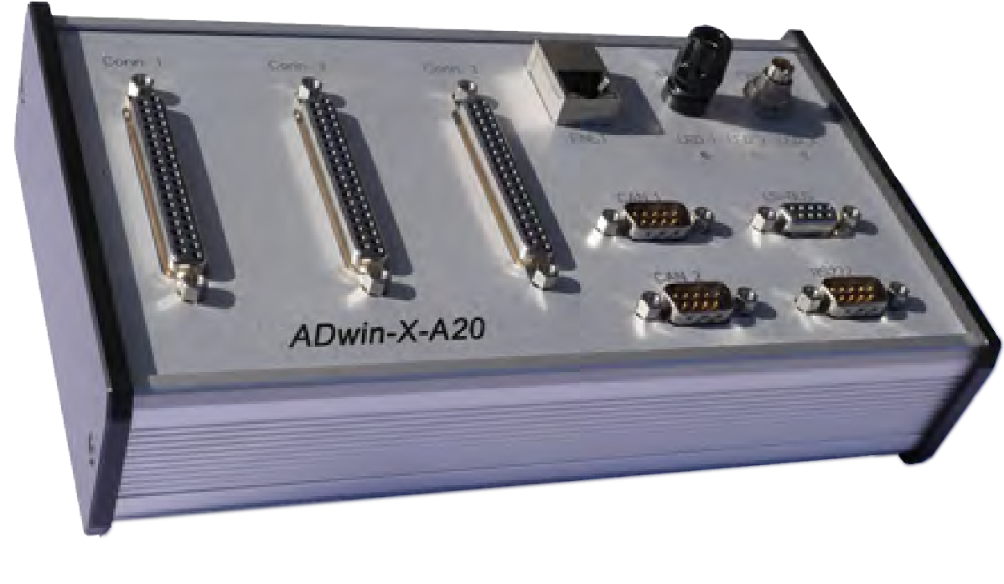
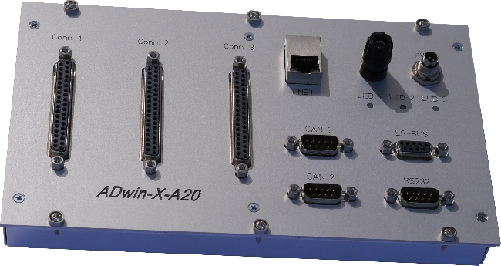
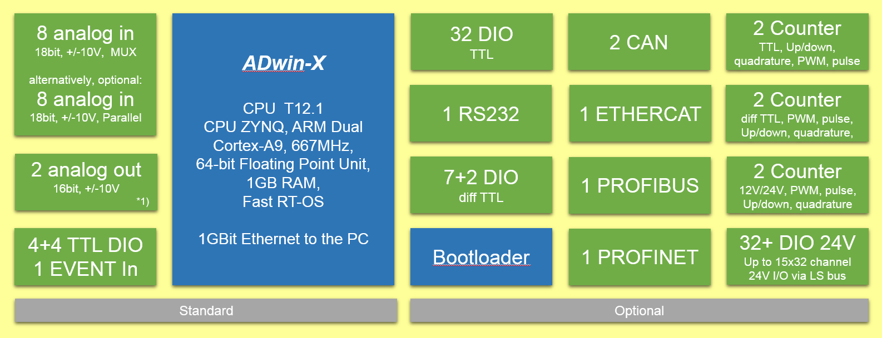
ADwin-X-A20
ADwin
ADwin always provides a very accurate, precise, and deterministic timing, with a high speed process execution.
ADwin-X-A20 is the newest member of the ADwin Real-Time systems family. It is compact and is designed for OEM applications to be used inside machines and devices. Like all ADwin systems it executes a fast, robust and flexible Real-Time code.
There are standard versions of ADwin-X-A20, as well as fully customized versions for OEM series applications.
ADwin-X-A20 is freely programmable by the user. The software of the system can be designed using the ADbasic tool chain or Matlab® /Simulink ® and it can be adapted just in software for many kinds of applications and solutions. For the data exchange with a PC, all drivers are available for ADwin-X-A20.
In general, ADwin offers more than 25 years of experience in automation and deterministic Real-Time applications. With software solutions since 1987, and with ADwin hardware systems since 1992, many thousands of users and applications worldwide rely on these precise and robust systems.
ADwin systems are the core of various test stands, machines and scientific experiment controls.
For Lab applications, desktop or DIN-rail
For 19” enclosures

Slide 8
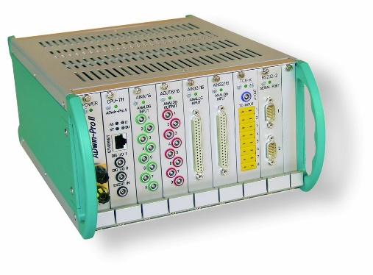
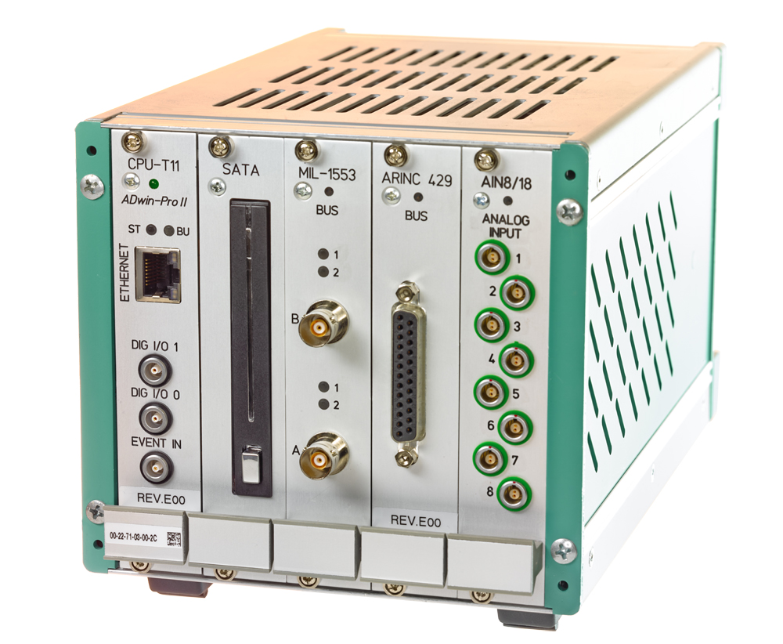
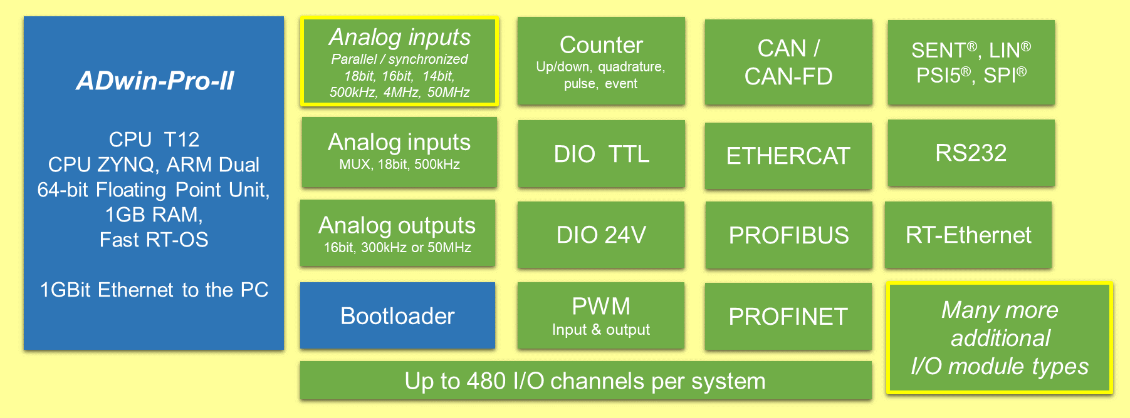
ADwin-Pro II
ADwin
The ADwin Pro-II System
ADwin Pro-II is a modular, scalable, expandable, intelligent Real-Time system for fast data acquisition and control applications in industrial and scientific environments.
The modular design of ADwin Pro-II offers a flexible, adaptable solution for various applications. It supports signal counts from single channels up to hundreds of channels.
A wide range of different analog & digital I/O module types, many kind of interfaces, various enclosures, processors and memory options, allows a customization of the system for a universal use, especially in industrial applications.
ADwin-Pro-II systems are the core of various test stands, machines and scientific experiment controls.
The ADwin Pro-II enclosures are available in different form factors and power supply options.

Slide 9
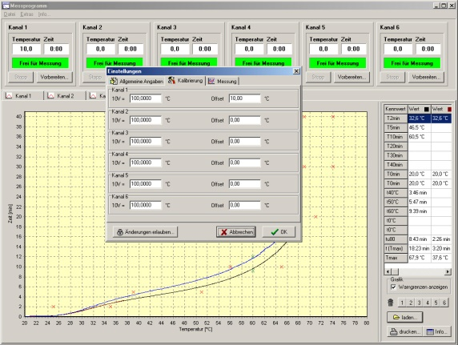
ADwin
Turnkey Solutions,
Customization, Workshops
Consultancy, Services, Workshops
Pre- and post-sales consultancy, and individual application- oriented workshops, are one of the great benefits of using ADwin systems. Take advantage of it and feel free to contact our experienced team, we will discuss your project jointly with you to solve your needs.
Concerning long term delivery, most ever produced standard ADwin products are available for support or there are compatible alternatives.
Turnkey Solutions and Projects
Turnkey solutions are realized by the ADwin project team. Experienced engineers realize various kinds of customer specific solutions for test-stands and machine automation.
Our service includes user interface software design (GUI), if required ADwin hardware development, up to complete machine automation software.
Customized Systems
Beside our standard products, system customization is always a key to solve application needs for OEM applications. If an application requires any kind of new features, the ADwin engineering team is able to close this gap with customized hardware or software.
OEM systems may be created in adapted in terms of enclosure design, number and type of I/OS, or any special reuirement.
Simulink® blocks for Customized and Turnkey solutions
In case of customized hardware for OEM applications or special module designs, also matching Simulink blocks may be offered.

Slide 10
ADwin
Additional Information
Please find additional information in the current full ADwin brochure “Simply more realtime, available as PDF or printed in different versions :
English
French
Italian (Short version)
Please request Your PDF version by Email, or feel free to visit ADwin online for additional Information.

Slide 11
April 2021
ADwin
Fast Real-Time Systems
de

